Slide 1
Presentation Title Two Lines Go Here
Name of Event | Date of Presentation

Slide 2
Agenda headline
Event Name: Presentation Date
Agenda item one

Slide 3
Full-service integrated marketing
Healthcare-specialized growth partner
Catalyst of change
Strategy-first approach
Data-driven decision making
Tech-enabled growth solutions
Experts in marketing, branding and advertising
Comprehensive strategic and tactical expertise

Slide 4


Growth advisors who work as an extension of your team
Formed in 2024 by combining the strengths of four healthcare marketing firms
Core team: strategists, data analysts, project managers, writers, designers, videographers, communication experts, web/digital developers
Advanced expertise in strategy and integrated digital marketing solutions for consumer and professional audiences
No learning curve: In-depth, hands-on experience in all aspects of healthcare and medical marketing

Slide 5
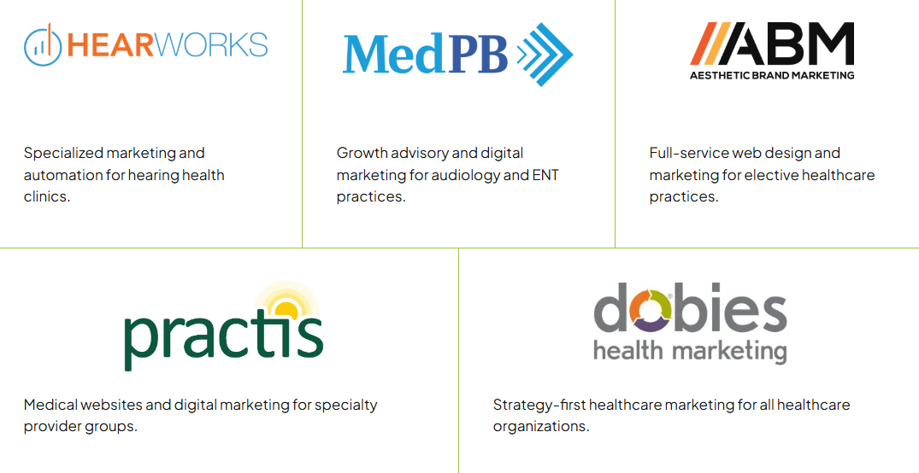
Deep expertise that propels our clients to unparalleled success

Slide 6


Promise
Accelerate intelligent growth.
Vision
As the epicenter of purpose-driven growth, we will inspire better, more sustainable health for providers, people and communities.
Mission
We ignite long-term growth for our healthcare clients through strategy and integrated digital marketing solutions.

Slide 7

How we accelerate intelligent growth
Serving as your strategic growth partner
Measure, report and adjust
Strategy: assess goals
Accelerate
growth
Data: competitive insights
Build and deploy solutions
Plan: enable growth

Slide 8
Our clients
Medical Practices
Aesthetics and dermatology
Audiology, hearing health and ENT
Urology and urogynecology
Behavioral health
Primary care, women’s health, cardiology, orthopedics, dentistry and more
Hospitals
Local, regional and national health systems
Academic medical centers
Community hospitals
Specialty hospitals
Surgery centers
Rural hospitals
Critical access hospitals
Other Healthcare Enterprises
Tech-enabled health services
Medical device and diagnostics firms
Health plans/payers
Certifying and credentialing boards
Member associations
Notes:
Hospitals and health systems
All other healthcare enterprises, including:

Slide 9
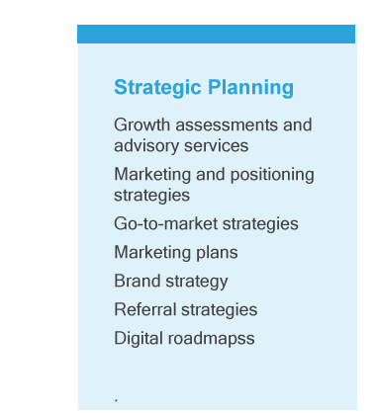
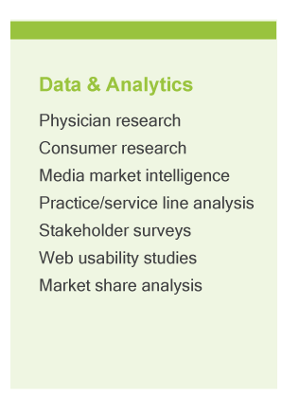
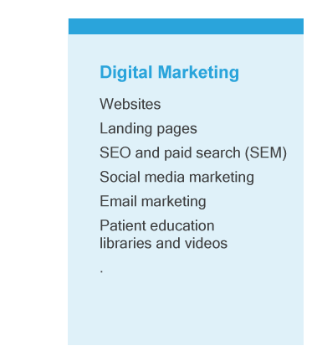
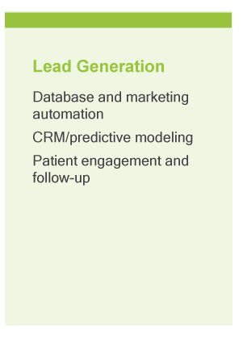
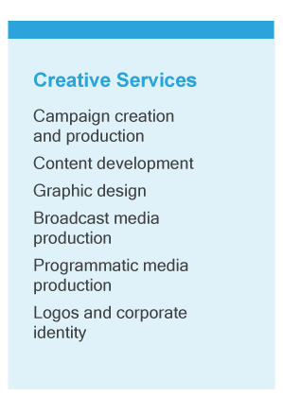
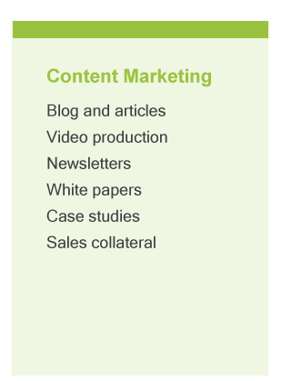
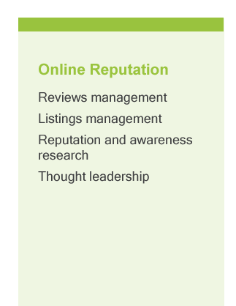
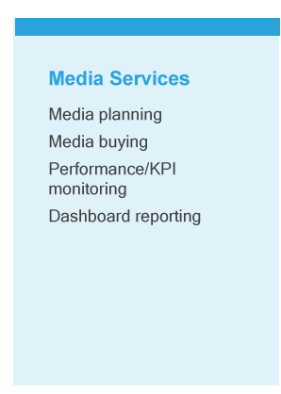
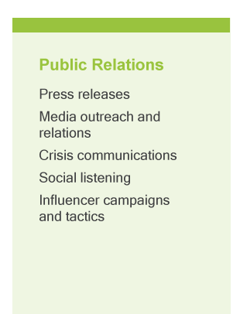
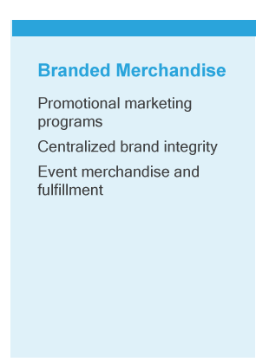

Our services
Full-service, integrated and tech-enabled healthcare marketing

Slide 10

Proposal highlights
Bullet one copy goes here this is bullet one copy.
Bullet two copy goes here this is bullet two copy.
Bullet three copy goes here this is bullet three copy.
Bullet four copy goes here this is bullet four copy.

Slide 11
Add account team

Slide 12

Add specific case studies/creative samples

Slide 13
Thank you.

Slide 14
APPENDIX

Slide 15
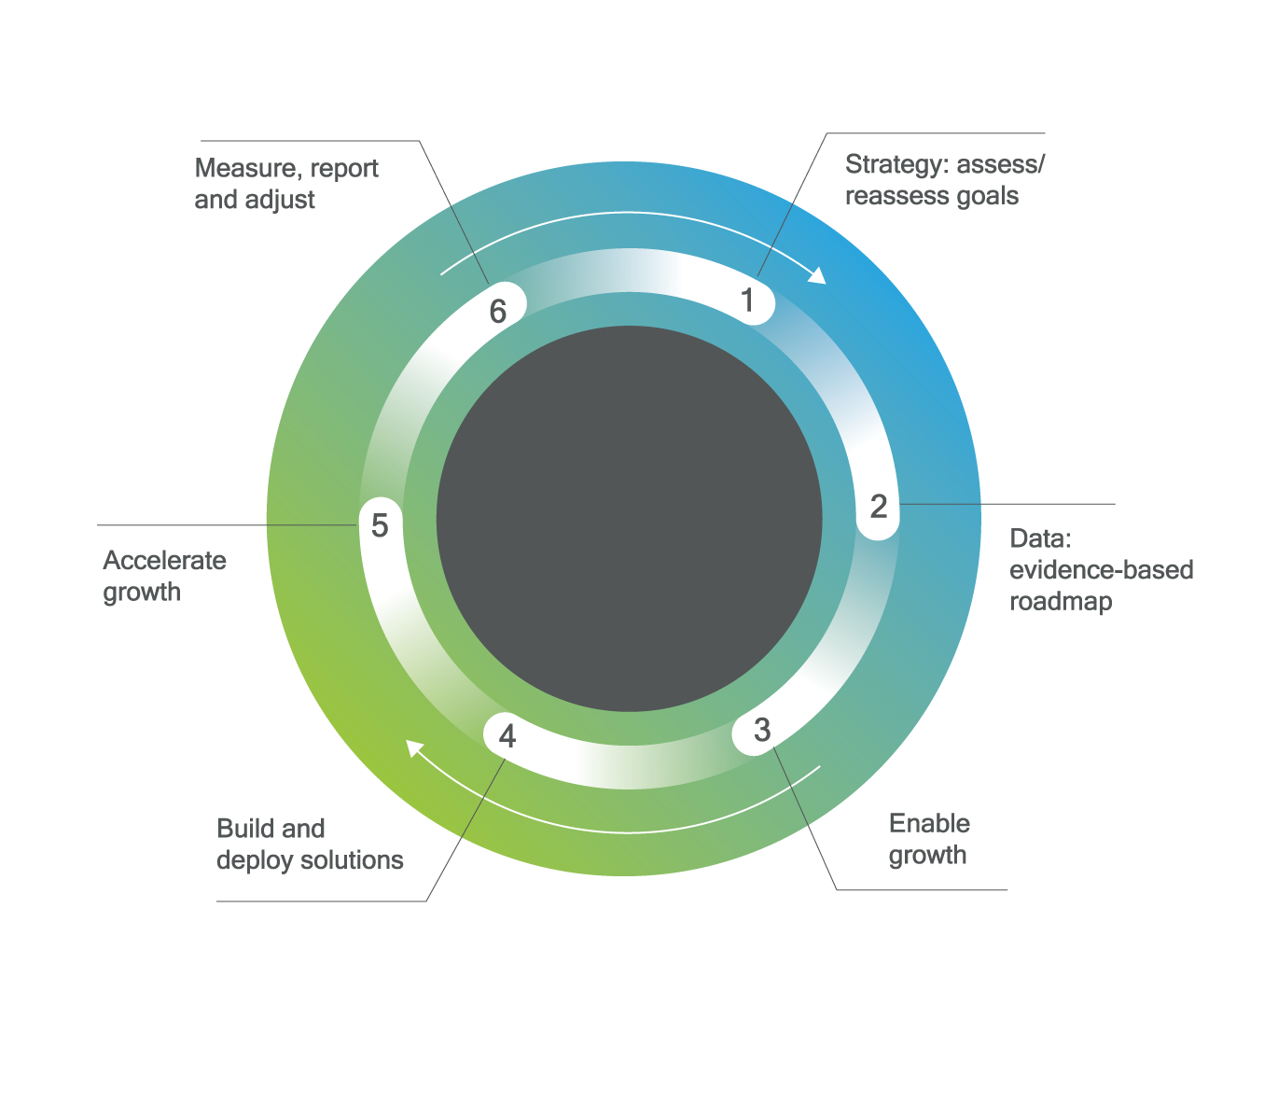
Chart styles
Pie graphics with simple gradient inside circle from green to blue and callout numbers around the circle
Title goes here this is the title
Title Goes Here This Is The Title

Slide 16
Chart styles
Bar graphs style with gradient simple tone on the bottom

Slide 17
Chart styles
Line graphs with simple clean lines

Slide 18
Stat styles
CAPS TITLE
24%
CAPS TITLE
27%
CAPS TITLE
74%
Name goes here
Name goes here
Name goes here
+XX
+XX
Xin X
Copy about this stat goes here
Copy about this stat goes here
Copy about this stat goes here

Slide 19











Icons
Audiology
Urology &
Urogynecology
Orthopedics
Dermatology
Medical & Dental Practices
Tech-Enabled Health Services
Hospitals & Health Systems
Medical Device & Diagnostics
Behavioral Health
Payers
Boards & Associations

